Slide 1
Art of the Business Transfer
EXIT: A Guide to Selling a Company
The Vant Group
17766 Preston Road
Dallas, TX 75252
Alex Vantarakis
Founder, President
alex@thevantgroup.com
(972) 458-8989 ext. 102

Slide 2
ART OF THE BUSINESS TRANSFER (AOBT)
  8:00 – 8:15 Meet & Greet
  8:15 – 8:25 The Vant Group Intro
  8:25 – 8:35 Introductions (30 seconds)
  8:35 – 9:20 Art of the Business Transfer Discussion
  9:20 – 9:30 Roundtable Discussion: 5 questions

Slide 3
AOBT: Introductions
Name, Company Name and Industry
What are your expectations from this event?
Have you ever been involved in an M&A transaction for your or one of your clients

Slide 4
The Vant Group Overview
About The Vant Group
Our Values
Experienced M&A firm since 1999
Specialize in transactions for businesses with revenues up to $50 Million
Focused on the Southwest U.S. with a national footprint
Motivated staff of MBAs and prior business owners
Authority on Business Transfer having authored two books: EXIT and ENTRANCE
Innovative Five-Point Advantage
Go Above and Beyond in All We Do
Build Lasting Relationships
Put Our Client’s Interests First
Trust Must Be Earned
Continually Educate Ourselves & Our Clients
Honesty is the Best Policy
Promote a Team Environment

Slide 5
The Vant Group Difference
Experienced in the Art of Business Transfer
  TVG Longevity and high number of closed transactions
Entrepreneurial Mindset
  Buying and selling for our own portfolio for over 20 years
Proactive Approach
  Anticipating and eliminating “deal killers” before they happen
Proven Methodology
  Systematic approach throughout the entire process
Relationship Driven
  Extensive relationships with buyers, bankers, and professional service providers

Slide 6
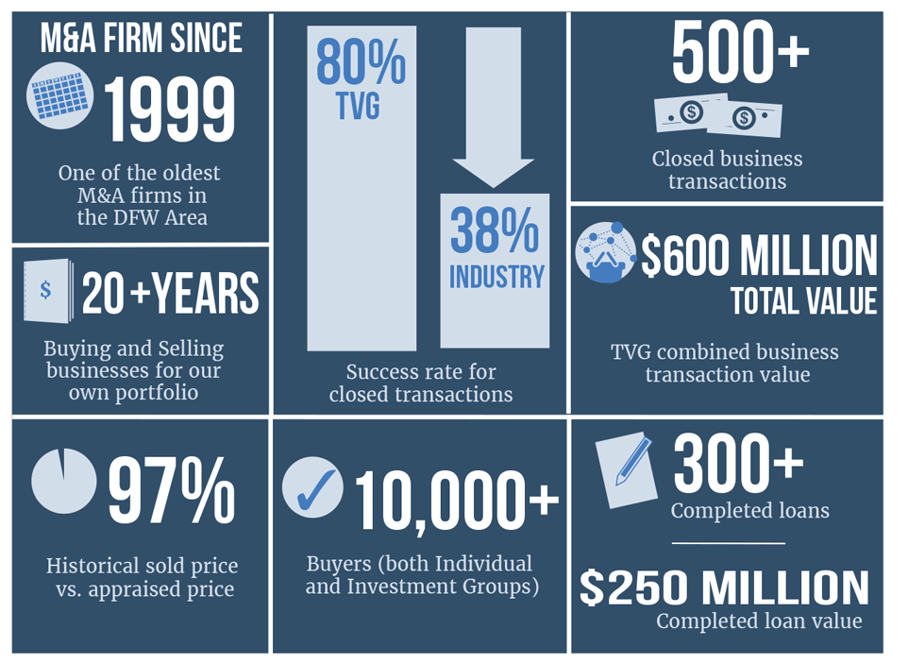
TVG by The Numbers

Slide 7

TVG Five-Point Advantage
Seller Representation
Buyer Representation
Valuation Reports
Advisory Services
Debt Funding

Slide 8
The Five Point Advantage
Seller Representation
Seller Representation
“We’ve sold 80% of our listings vs. the industry average of 38%”
Traditional Sale: Synergistic Corporate Buyer or Individual Buyer; financing terms vary Facilitation Sale: Buyer is identified by the seller and requires business transfer expertise Employee Buyout: Up to 10% down payment, 0%-10% owner financing, 80%-90% bank financing Partner Buyout: Up to 10% down payment, 90%-100% bank financing
Buyer Representation
Valuation Reports
Debt Funding
Advisory Services

Slide 9
The Five Point Advantage
Seller Representation
Buyer Representation
“Our Buyer Representation goes well beyond merely deal origination”
Corporate Buyer: Increase the revenue and value of an existing business through acquisition Individual Buyer: Live the American Dream by becoming a business owner
Buyer Representation
Valuation Reports
Debt Funding
Advisory Services

Slide 10
The Five Point Advantage
Seller Representation
Valuation Reports
“Our clients obtain 97% of their appraised price because our business valuations are built on experience”
Opinion of Value: Basic report to gauge value Full Business Valuation: Detailed report for exit planning, funding needs, and legal proceedings Accredited Business Valuation: Specialty case valuation for certain non-standard purposes
Buyer Representation
Valuation Reports
Debt Funding
Advisory Services

Slide 11
The Five Point Advantage
Seller Representation
Debt Funding
“Growth depends on capital”
Buying a Business: Up to 10%+ down payment, 10-year term, 6% interest rate Starting a Business: Up to 30% down payment, 10-year term, 6% interest rate Working / Expansion Capital: Terms based on profitability, accounts receivable, and projected revenue Owner-Occupied Real Estate: Up to 10% down payment, 25-year amortization, 4%+ interest rate
Buyer Representation
Valuation Reports
Debt Funding
Advisory Services

Slide 12
The Five Point Advantage
Seller Representation
Advisory Services
“Is your business ready to be sold at the maximum value?”
Business Health Assessment: Is a business ready to be sold at maximum value?; Implement TVG Advantage if necessary Revenue Growth and Cost-Reduction Services: Ultimately increasing bottom-line profit Employee & Operational Effectiveness: Having all employees moving in the same direction Project-Based & Monthly Consulting: Guidance along the way to implement impactful strategies
Buyer Representation
Valuation Reports
Debt Funding
Advisory Services

Slide 13
Summary
The Seller’s Advantage
  Traditional Sale
  Facilitation Sale
  Employee Buyout
  Partner Buyout
The Buyer’s Advantage
  Corporate Buyer
  Individual Buyer
The Valuation Advantage
  Opinion of Value
  Full Business Valuation
  Accredited Business Valuation
The Business Advisory Advantage
  Business Health Assessment
  Growing Revenue
  Maximizing Employee Operational Effectiveness
  Project- based and Monthly Consulting
The Funding Advantage
  Buying a Business
  Starting a Business
  Growth / Expansion Capital
  Owner-occupied Real Estate

Slide 14

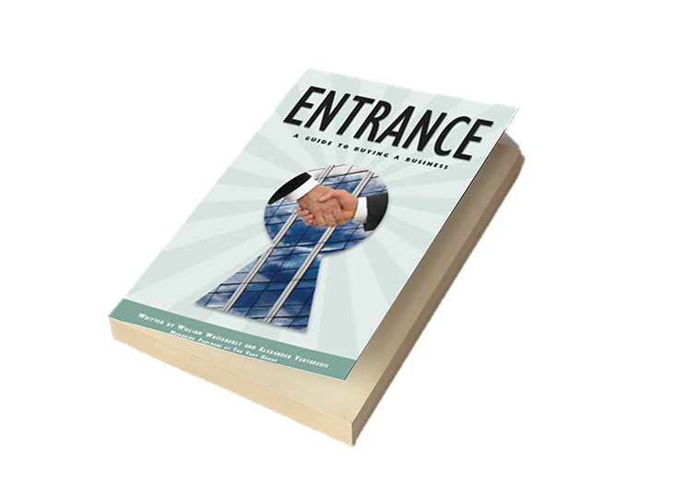
Industry Authority
Authored Two Books on The Art of Business Transfer
We are committed to thought leadership
Business Owner’s Guide to Selling a Company
Business Owner’s Guide to Buying a Company

Slide 15
TVG – The Selling Process
Preparation
10-16 Days
Marketing
13-24 Days
Due Diligence
14-155 Days
Negotiation
52-115 Days
Initial Meeting
Begin Marketing Business
Interviews and Filter Buyers
Negotiations Between Buyer and Seller
Review Financials
Develop Marketing Package
Buyer and Seller Meetings
Solidify Price and
Deal Structure
Determine Value
Seller Approval of
Marketing Package
Buyer Submits LOI / Offer to Purchase
Apply / Obtain Financing
Engage Services
Finalize Purchase Agreement
Gather Information
Average Duration
90 – 300 days
Business Closing

Slide 16
TVG Client Marketing Process
Internal database:
  3,000 + Individual Buyers
  7,000 + Private Equity Groups
Internet marketing on multiple business transfer websites
Direct marketing:
  Synergistic industry companies
  Competitors and/or vendors (if applicable)
Analyze internal buyers – employees and/or partners (if applicable)
Working with professional service providers who have contact with thousands of buyers

Slide 17
Selected Industries Represented
Professional Services
Commercial Landscape CPA Firm Medical Billing Environmental Consulting
Janitorial Services Website Hosting IT Services Civil Engineering Design
Consumer Services
Call Center Carpet Cleaning Commercial Printer HVAC Service
Pest Control Therapy Practice Glass Cleaning Auto Services
Manufacturing
Custom Door Custom Glass Electronics Aircraft Parts & Supplies
Pallet Plastics Products Tubular Products Commercial Sign
Wholesale / Distribution
Building Supply HVACR Wholesaler Janitorial Supply Promotional Products
Scrap Metal Specialty Oxygen Water Filtration Wholesale Electrical
Construction
Concrete Foundation Niche Construction Pool Construction Stone & Masonry Supply
Lathe & Plaster Commercial Concrete Fire Sprinkler General Contractor

Slide 18
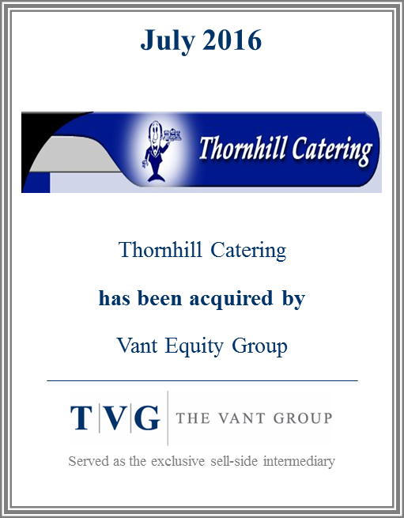
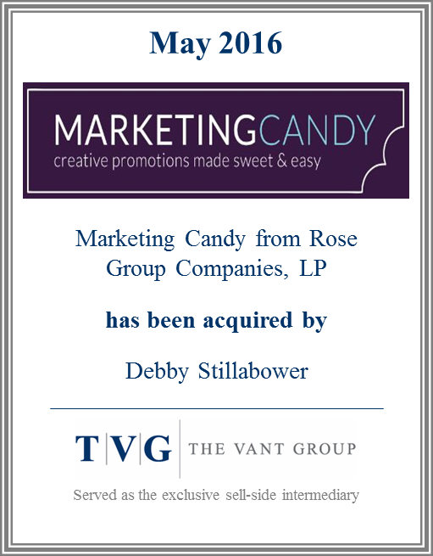


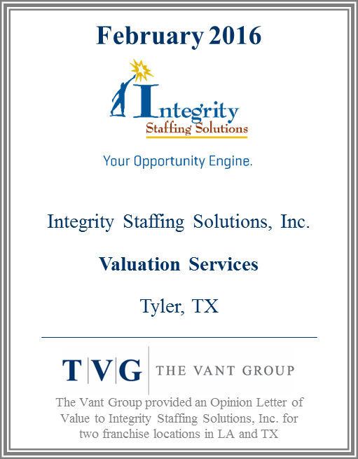



Selected Transaction Experience

Slide 19
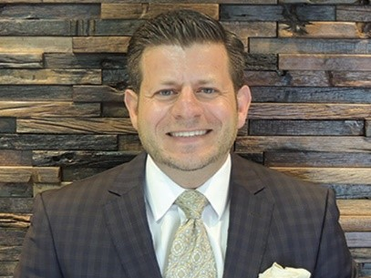
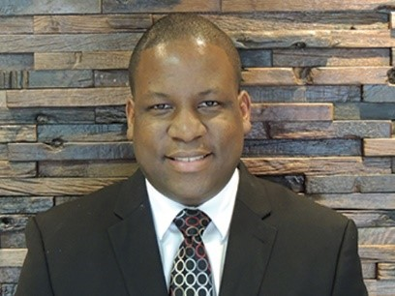
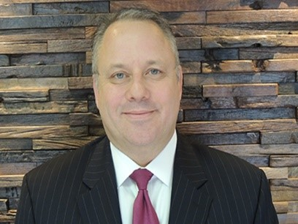
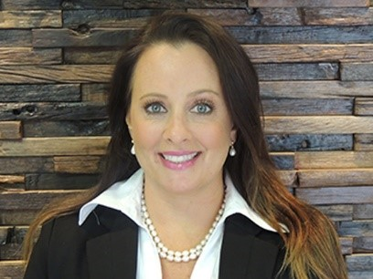
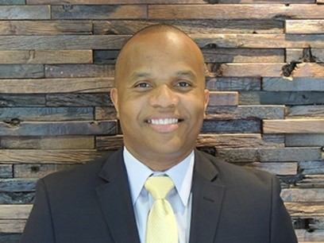
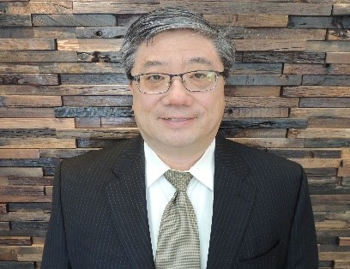
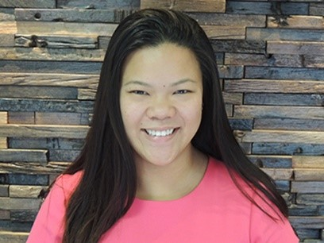
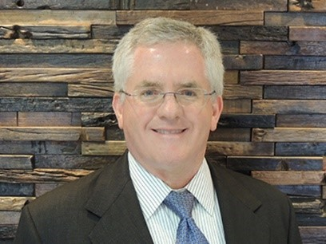
TVG Team
Alex Vantarakis, Founder
Anthony Cullins, Partner
Dirk Armbrust, Managing Director
Julie Fleming, Managing Director
Dwayne Evans, Managing Director
David Wang, Corporate Counsel
Simone Tan, Operations Manager
Ed Belanger, Business Valuations

Slide 20

Meet Alex Vantarakis
Expert M&A Advisor
Leads The Vant Group with an accomplished record of success in mergers and acquisitions
More than 20 years of experience in a wide variety of sell-side and buy-side business transactions
Experience across multiple industries in business transfer transactions
Additional expertise in areas of business valuations and debt funding, finance, franchise development and strategic planning
Alex Vantarakis
Founder, President
Education
Author & Keynote Speaker
BS from Boston College
  Finance Major
  Graduated with Honors
MBA from Babson Graduation School of Business
  Concentration in Finance and Business Development
  Graduated with Honors
Author and speaker who educates companies in the essential principles of the business-transfer process
Co-authored two books which outline the process for small to mid-size companies: EXIT and ENTRANCE
Lecturer to a variety of business association groups

Slide 21

Meet Dirk Armbrust
Expert M&A Advisor
20 years of operating, M&A transaction, turnaround, advisory, acquisition, carve-out, and business development experience.
Prior to joining The Vant Group:
  Director in one of Dallas’ leading Investment Banking and Operations Advisory firms.
  Market Manager with 7-Eleven where he had P&L responsibility for over 120 stores, and led all operating aspects of his franchised market.
  Executive Leadership Team as a Regional VP with a privately-held $100MM+ industrial packaging company.
  Led four distribution centers with International Paper; started, built, and sold a contract manufacturing business; and led teams with Dell Computers’ supply chain and manufacturing groups.
Dirk Armbrust
Managing Director
Education
MBA from Wake Forest University studied International Business at Oxford
Bachelor of Science in Management from the US Air Force Academy.
Mr. Armbrust is a Black Belt Certified Lean/Six Sigma practitioner.
Dirk served in Texas, Europe, the Middle East, and North Africa.

Slide 22

Meet Julie Fleming
Relevant Work Experience
16 years of small business and entrepreneurial experience.
Prior to Joining The Vant Group
Co-founded a small business in 2000 and served as President of the company until 2012.
In 2012, Julie joined a business focused CPA firm and served as Director of Operations.
In 2014, Julie co-founded a consulting firm that focused on business growth and health. Teaching and implementing a proven operating system called the Entrepreneurial Operating System from the book Traction, Julie helped business owners grow and get what they want out of their business.
As a Gallup Certified Coach, Julie has a knack for getting the best out of people and loves to help others identify and achieve their goals.
Julie serves on the Women’s committee for the Association of Corporate Growth.
Julie Fleming
Managing Director
Education
Julie is an “almost” native Texan graduating Magna cum laude from the University of Texas at Dallas
Bachelor of Science in Business Management with an emphasis in Accounting.
In 1994, Julie passed all four parts of the CPA examination.

Slide 23
Art of the Business Transfer: TOPICS
How you help your client in an M&A transaction
Tax Implications of a Sale
Key Factors Influencing Value
Getting Your Business Ready for Sale
Sale Price Misconceptions (pyramid of CF and multiples)
Lack of Management in Place
Bad Advisory Team
Employee / Partner Buyout
Buy-Sell Agreement / Buyout Agreement
Post-transaction Issues

Slide 24
Art of the Business Transfer: TOPICS
Working Capital Impact on Valuations
Founder’s Trap
Questions to Ask a Seller
Common Deal Killers in Transaction
Owner Financing
Why Businesses Fail after a Sale?
Common Red Flags on a Business for Sale
Benefits of Using an Intermediary
Business Sale Process
Small Businesses vs Middle Market Businesses

Slide 25
Art of the Business Transfer: ROLE PLAY
What’s the selling process?
I think I may already have a buyer. Now what?
Who do you see buying my business? An individual or a larger company?
How do I maintain confidentiality during the process? I don’t want my employees to find out.
Do I have to have an exclusivity with you?
Seller Financing? What’s the deal with that? Do I have to do that?
Can I sell my business by myself?

Slide 26
Major Steps in the Sale Process
1
  Business owner decides to sell business
2
  Determine the value of your business
3
  Gather information into a marketing package
4
  Marketing the business
5
  Identify potential buyers
6
  Arrange meetings with buyer and seller
7
  Offer to Purchase / Letter of Intent – Moving Forward
8
  Negotiating and deal structure
9
  Due diligence
10
  Closing

Slide 27
Determining When to Sell
Burnout / boredom
Retirement (age)
Health
Economic factors
Lack of operating capital / need for growth capital
Industry overview
Employee stability
Sales / cash flow

Slide 28
Gathering Pertinent Documents
Interim profit & loss statement & balance sheet
Three years of tax returns & income statements
Current asset list
Assets and liabilities included in the transaction
Facility information – rent, size, location
Employee information - # of employees, salaries, longevity
Company history: years in business, product lines
Other information to include
  Asking price, deal structure and financing, marketing strategies, industry trends, industry trade journals

Slide 29
The Valuation Process
Objective Aspect | Subjective Aspect
Owner’s discretionary cash flow | Years in business
Asset value | Employees
Inventory value | Reason for selling
A/R and A/P included? | Length of training
Leverage – financing | Customer and supplier base allocation
Asset vs. stock sale | Business type: manufacturing, wholesale, service, retail
 | Other factors: Market strength, industry growth, appearance, location, owner’s involvement

Slide 30
Owner’s Discretionary Cash Flow
Example
Net income $ 500,000
Addbacks:
Depreciation $ 50,000
Interest $ 20,000
Owner Salary $ 80,000
Overpayment of rent (owns building) $ 10,000
One time expense (legal fees) $ 10,000
Underpayment of spouse’s salary $ (10,000)
Owner’s Discretionary Cash Flow $ 660,000

Slide 31
Who Are the Buyers
Employed Corporate Executive
Displaced Executive
Former Business Owner
Turn-Around Specialist
Individual Buyer
Strategic Buyer
Synergistic Buyer
Financial Sponsor (Private Equity Group)

Slide 32
Sell-Side Considerations
Working With Buyers
Negotiation & Deal Structure
Emotions
Picking the right buyer
Timely responses to information requests
Sale price
Allocation of sale price
Taxes
Handling assumed assets and liabilities
Earn out
Assets vs. stock
Non-compete agreements
Length of training
Earnest money
Showing a Business
External business appearance
Internal business appearance
Warehouse layout
Website
Financing
Closing
All cash
SBA loan
Conventional loan
Private equity funding
Asset-based lending
Escrow company
Neutral site
Title and lien searches
Timing
Closing date and the closing table

Slide 33
Why Use an Investment Bank?
Pricing a business
Buyer prospecting
Confidentiality
Higher sale price
Negotiating a better deal
Professional marketing program
The closing process
Handling the support team

Slide 34
Choosing an Investment Bank
Check credentials
Business ownership experience
Understanding cash flow and sale price analysis
Analysis of deal structure
Office location
Marketing plan
Buyer profiling
Confidentiality
References

Slide 35
Pitfalls to Avoid
Listening to other seller sale prices
Overpricing the businesses
Bad books and records
Proving owner perks
Unreported cash
Year-end adjustments
Attorneys
CPAs
Bad attitude
Spouse
Investment bank
Handling your support team
Messy business
Continue the course of business
Incorrect information

Slide 36
Preparation for Sale
Preparing for Selling at a Later Time
Increase sales annually | Remove yourself from the business
Develop a strong management team | Reduce the amount of owner perks
Sell off all unnecessary assets | Develop a strong sales force
Diversify the customer base | Develop an organizational chart
Reduce unnecessary large purchases | Eliminate unproductive employees
Keep accounts receivable (A/R) within 30-60 days | Keep your accounts receivable (A/R) high than your accounts payable (A/P)
Replace family members that work in the business | Reduce inventory to at least manageable level
Develop and / or improve company website | Have written procedures for operations

Slide 37
Roundtable Discussions
What do I need right now to help my business?
I have a client that needs help with the ________.
I have had tremendous success at growing my business through ________.
The biggest opportunities for my industry over the next 3 years are ________.
How do you differentiate yourself from Peers?
What is your takeaway today?

Slide 38
Great Care of Our Referral Sources
Your relationship with TVG is valuable to us
We take great care of your clients
  We act as an extension of your role as a trusted advisor
We pay referral fees
Alternatives to referral fees (if your profession or firm doesn’t allow it)
  Donations to charity
  Sponsorship of your year-end client or employee appreciation events – examples may include:
    Sharing in cost of event
    Door prizes
    Raffles

Slide 39
Value Add for You or Your Clients
Here is what TVG will offer to augment your business:
PDF version of our books: EXIT and ENTRANCE
Introduction to our Circle of Influence – Like AOBT attendees
Use of training and conference rooms
Complimentary EXIT plan consultation for your clients
Valuation overview analysis at a 20,000 foot level
Value Builder Assessment - score of between 1 and 100 for a business
Lecture series for your clients or your company employees
  Buying a business
  Business valuations
Selling a business
Preparing a business for sale

Slide 40
ART OF THE BUSINESS TRANSFER
Hope your enjoyed TVG’s Educational and Networking Event.
We look forward to seeing you again in near future.

Slide 41
Art of the Business Transfer
EXIT: A Guide to Selling a Company
The Vant Group
17766 Preston Road
Dallas, TX 75252
Alex Vantarakis
Founder, President
alex@thevantgroup.com
(972) 458-8989 ext. 102

