Slide 1


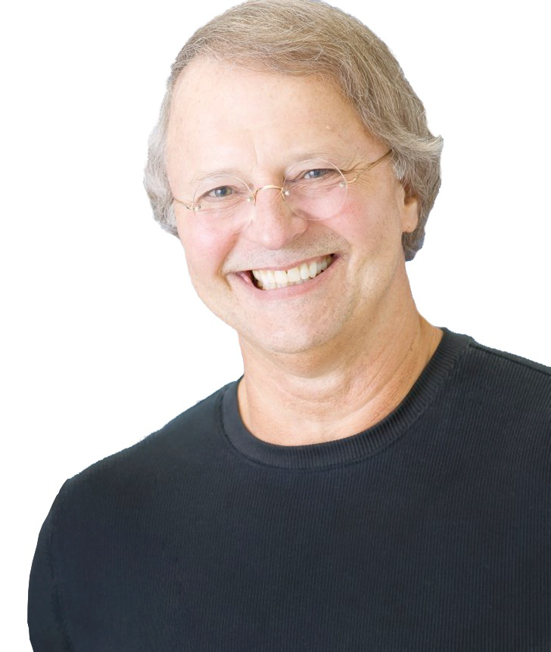
Dare Greatly!
Fail to
Succeed
™
Mike Muhney
Speaker | Author | Software Entrepreneur
(And Co-Inventor of ACT! Software)
Mike@MikeMuhney.com
October 26, 2017
Dallas, Texas

Slide 2
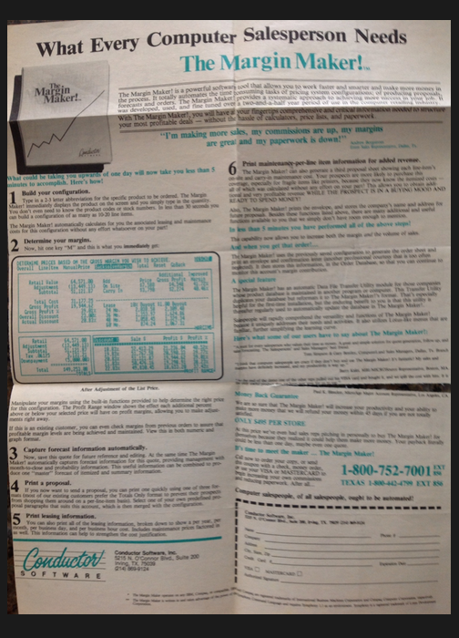

Slide 3
“The most difficult thing is the decision to act.
The rest is merely tenacity.”
—Amelia Earhart

Slide 4
“The most important shot in golf is the next one.”
—Ben Hogan

Slide 5
Our Agreement & Criteria...
Began With Having to Sell to Each Other
What did we need?
Rigid adherence to our concept we called “Useful Use”
We gave each other unmitigated veto power

Slide 6
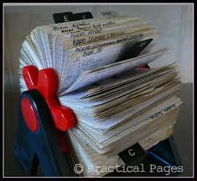
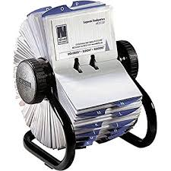

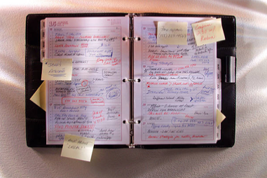
The Then Tools of Organization
The “Rolodex”
DayTimer/FiloFax

Slide 7
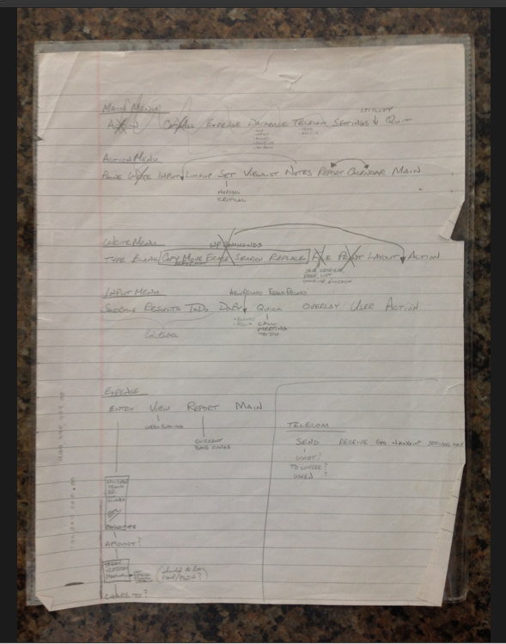
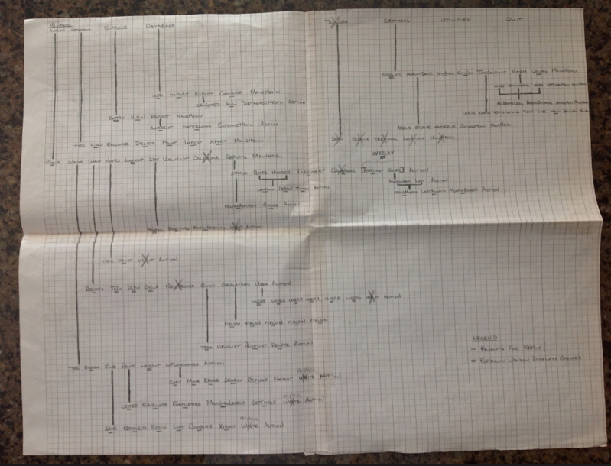
The Proverbial “Napkin”—Product Code Name “YES”
Conceived on
July 4, 1986

Slide 8
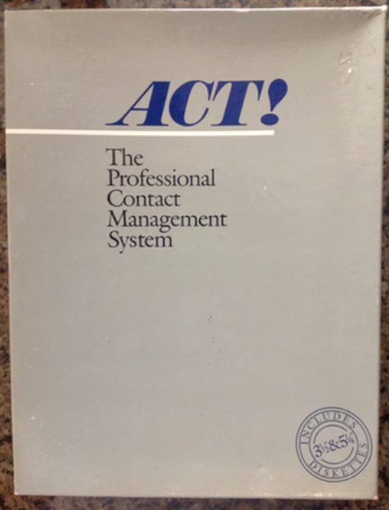
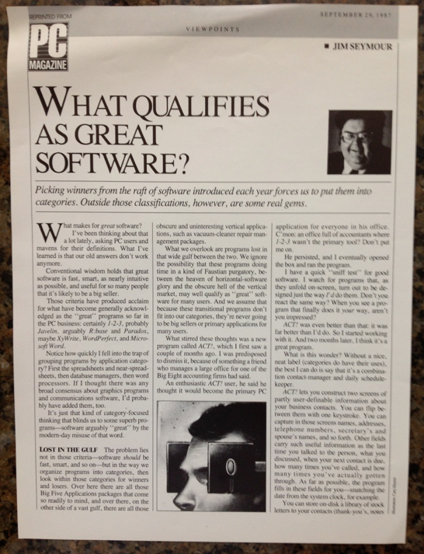
Version 1.0 - DOS - Released April 1, 1987
We created a new category and with it a new industry.

Slide 9
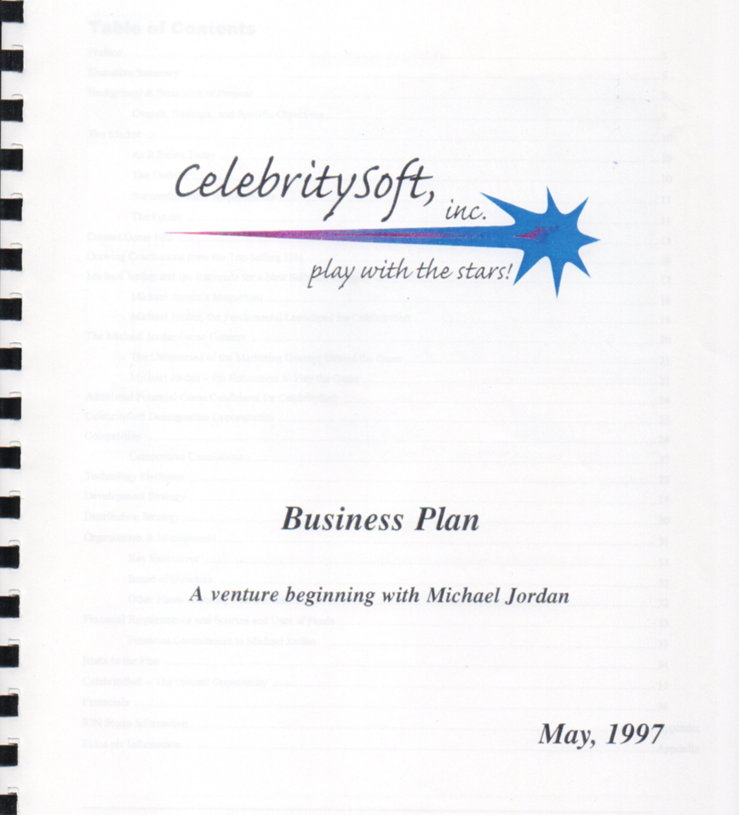
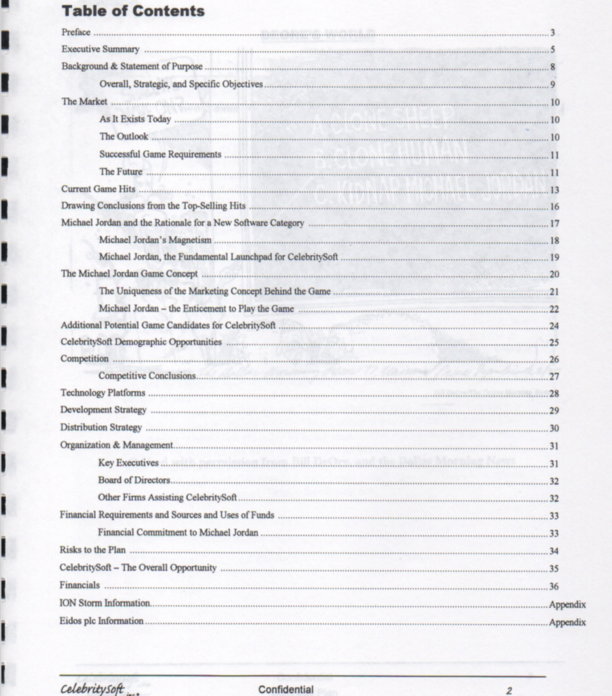

Slide 10




Slide 11
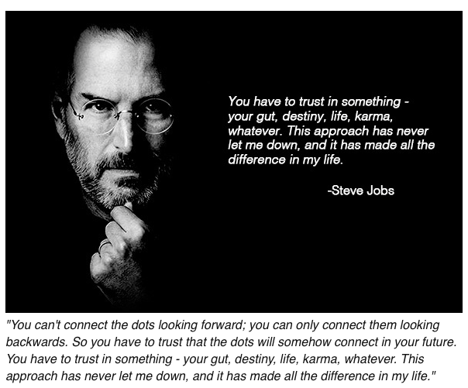

Slide 12

“Success is not final, failure is not fatal;
it is the courage to continue that counts.”
― Winston Churchill

Slide 13
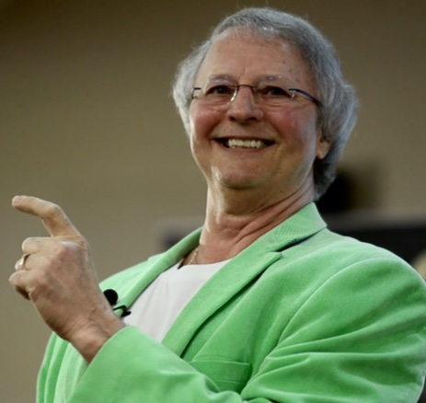
Thank You!
Let’s connect!
Email: Mike@MikeMuhney.com
Twitter: @MikeMuhney
Web: MikeMuhney.com

